Slide 1
Vijay Gupta
SPECIAL THANKS TO
The Rosenthal Family Foundation (Jamie Rosenthal Wolf, Rick Rosenthal, and Nancy Stephens) and Brownstein Hyatt Farber Schreck for their generous support of this keynote
OPENING REMARKS AND INTRODUCTION BY
The Honorable Nancy Pelosi, Speaker of the U.S. House of Representatives

Slide 2
1988 - 2020
33 Years of Arts and Public Policy Discourse at the Highest Levels

Slide 3
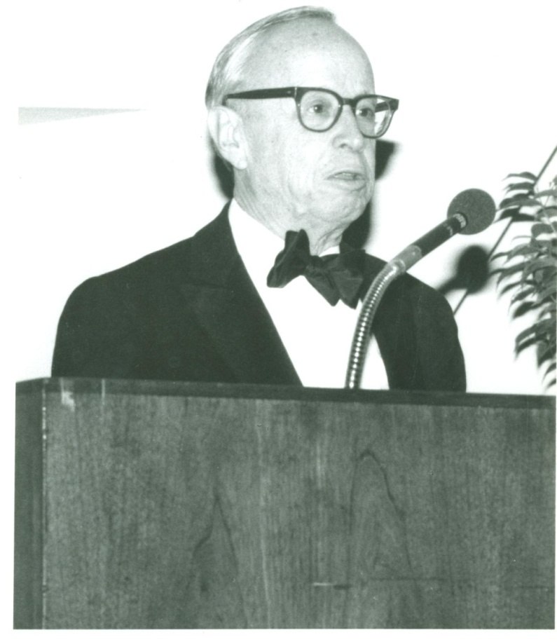
1988
“The public obligation is to safeguard the integrity of the artistic process and heritage. Surely government has as strong an obligation to preserve the cultural environment against dissipation and destruction as it has to preserve the natural environment against pollution and decay.”
Arthur Schlesinger, Jr. 1st Annual Lecturer
Notes:
1988 Arthur Schlesinger, Jr., historian

Slide 4
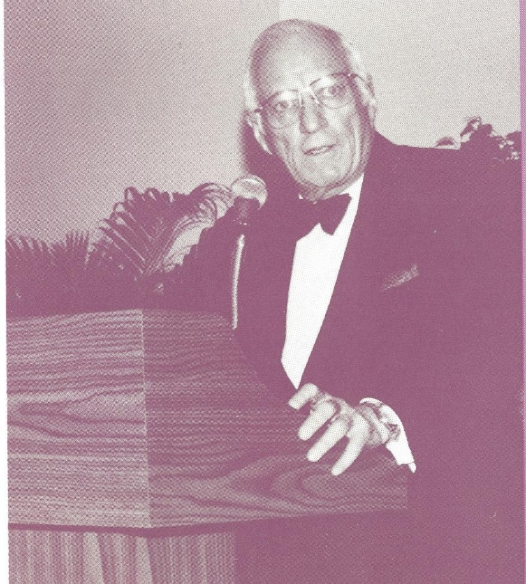
1989
“What do the arts need, and what is appropriate at this particular time and place? The answer lies in the nation’s agenda for education.”
Leonard Garment 2nd Annual Lecturer
Notes:
1989 Leonard Garment, Special Counsel to Presidents Nixon and Ford

Slide 5
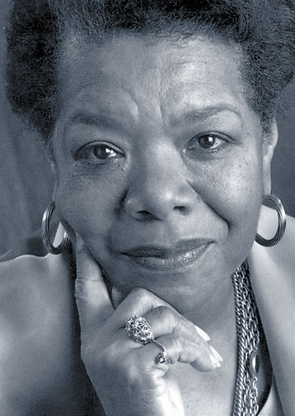
1990
“Art needs to ask us, ‘What do we think is our reason for being on this earth? What do we think is our right to abide on this planet? What is our duty to the planet? To other forms of life, with whom we are connected? To our own species?’”
Maya Angelou 3rd Annual Lecturer
Notes:
1990 Maya Angelou, poet

Slide 6
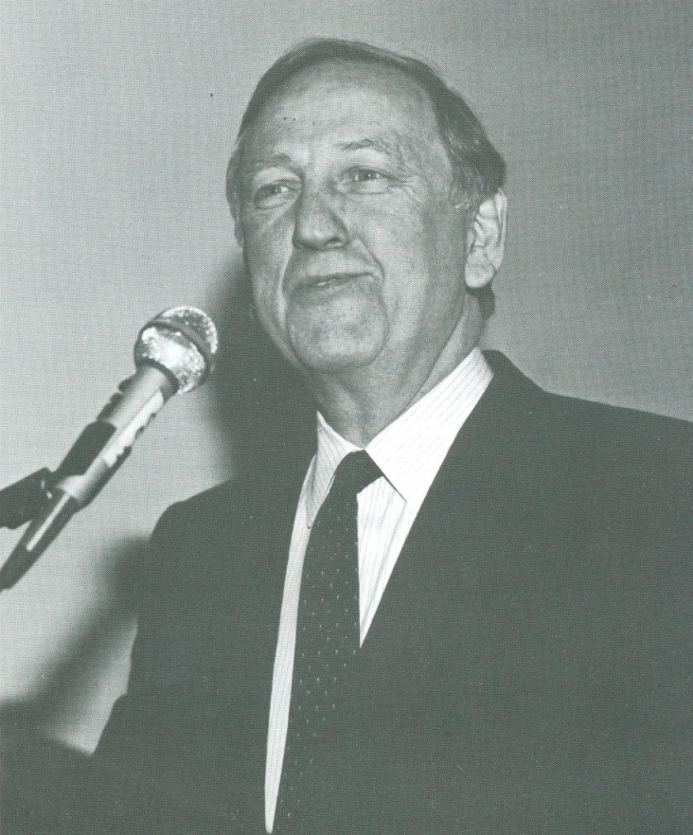
1991
“The arts are not something to be thrown a bone after everything else is taken care of because everything else will never be taken care of. And it will be up to each of you to make clear that the arts matter.”
John Brademas 4th Annual Lecturer
Notes:
1991 John Brademas, former Congressman, President Emeritus of New York University

Slide 7
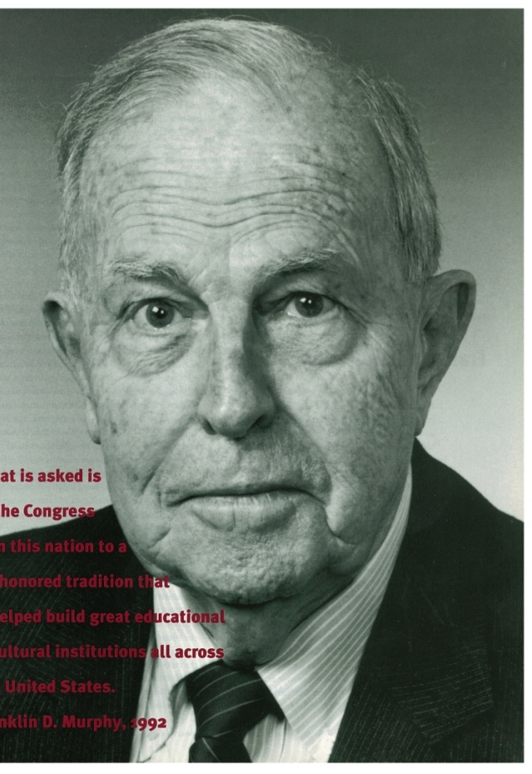
1992
“In a nation such as ours, the ability of Americans of different ethnic backgrounds to display their unique cultural skills to themselves and to others becomes important to their sense of self and a source of pride to be shared with Americans of other backgrounds.”
Franklin D. Murphy 5th Annual Lecturer
Notes:
1992 Franklin D. Murphy, former Chief Executive Officer of the Times Mirror Company .left

Slide 8
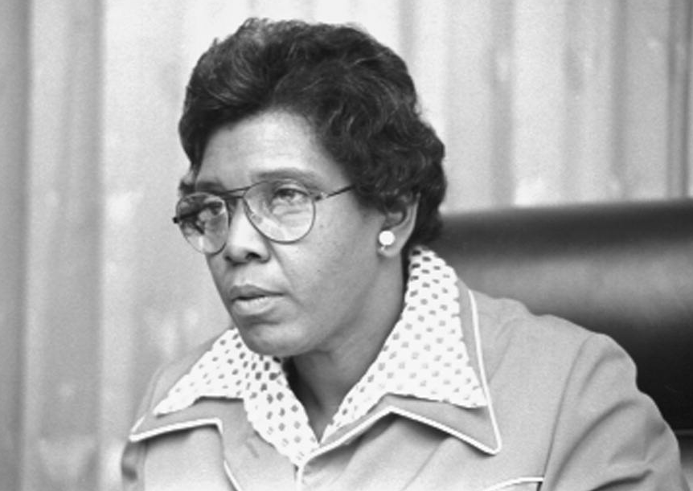
1993
“The arts, instead of quaking along the periphery of our policy concerns, must push boldly into the core of policy. The arts are a response to our individuality and our nature and help to shape our identity.”
Barbara Jordan 6th Annual Lecturer
Notes:
1993 Barbara Jordan, former Congresswoman .right

Slide 9
1994
“Especially in the arts, you learn to bring out what is unique in you, to express yourself, your feelings, and to experience the incomparable high-octane lift of that.”
David McCullough
7th Annual Lecturer
Notes:
1994 David McCullough, historian .left

Slide 10
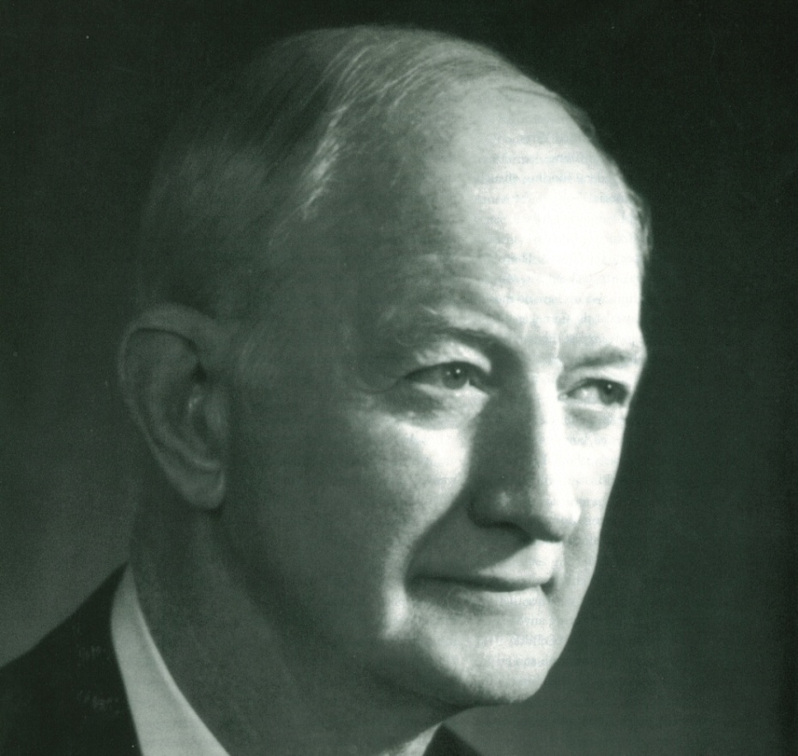
1995
“You never know about art. It has a way of coming back around. It connects us; it provides the ligaments and the ties that bind, holding the species together along the trajectory of its evolution. In that sense, among many, it can be said to perform a public function, in the purest sense of the word.”
Winton Malcolm Blount
8th Annual Lecturer
Notes:
1995 Winton Malcolm Blount, Chairman of Blount, Inc., philanthropist, former U.S. Postmaster General .right

Slide 11
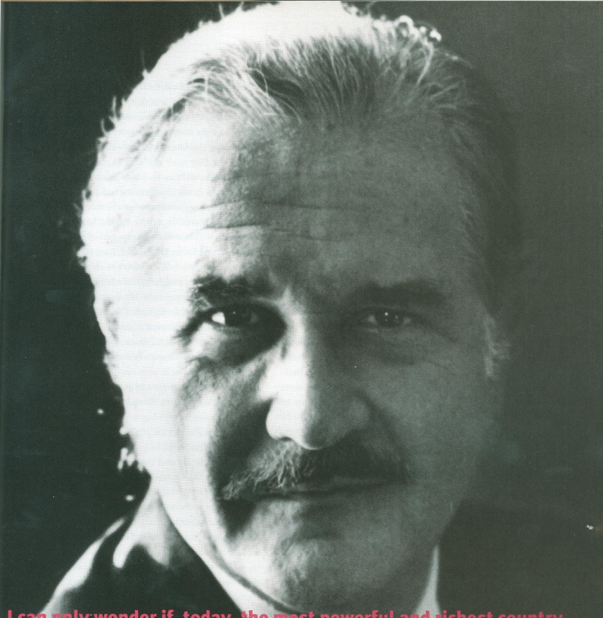
1996
“Culture and the arts are at the very root of that fragile and powerful creation which is a human personality. They are also at the summit of any given nation’s capacity for acting constructively on the world scene.”
Carlos Fuentes 9th Annual Lecturer
Notes:
1996 Carlos Fuentes, author .left

Slide 12
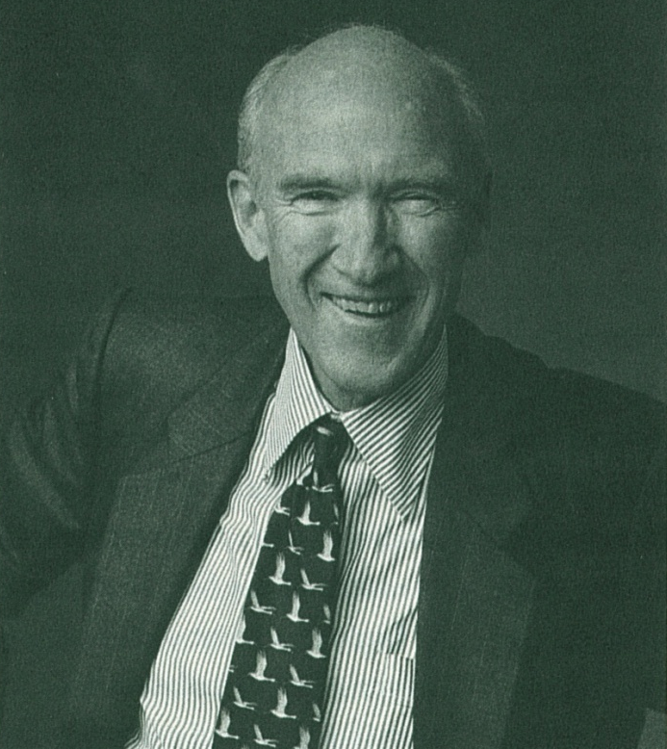
1997
“The harsh reality of increased restraints on the federal budget and efforts to curb the deficit should never force us to be silent about the value of the arts if we focus on our great strengths as a country: a public culture.”
Alan K. Simpson 10th Annual Lecturer
Notes:
1997 Alan K. Simpson, former U.S. Senator .right

Slide 13
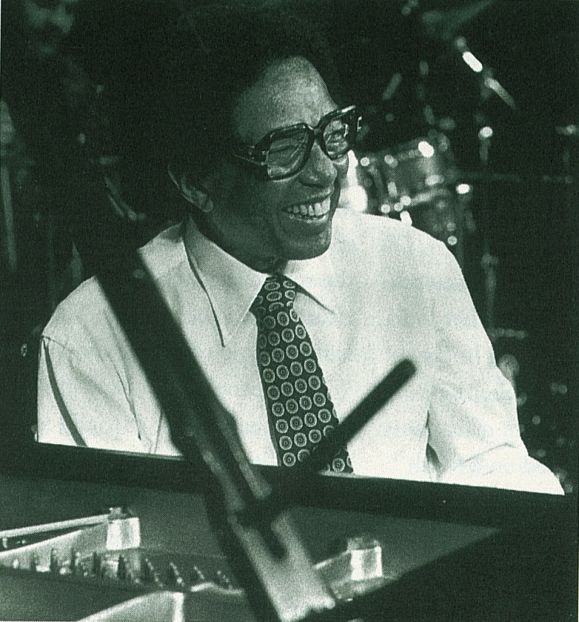
1998
“There are thousands of American artists who are well trained and ready and willing to use their creativity for the good of the society that spawned them. We should not waste this resource.”
Dr. Billy Taylor 11th Annual Lecturer
Notes:
1998 Dr. Billy Taylor, jazz musician and educator .left

Slide 14
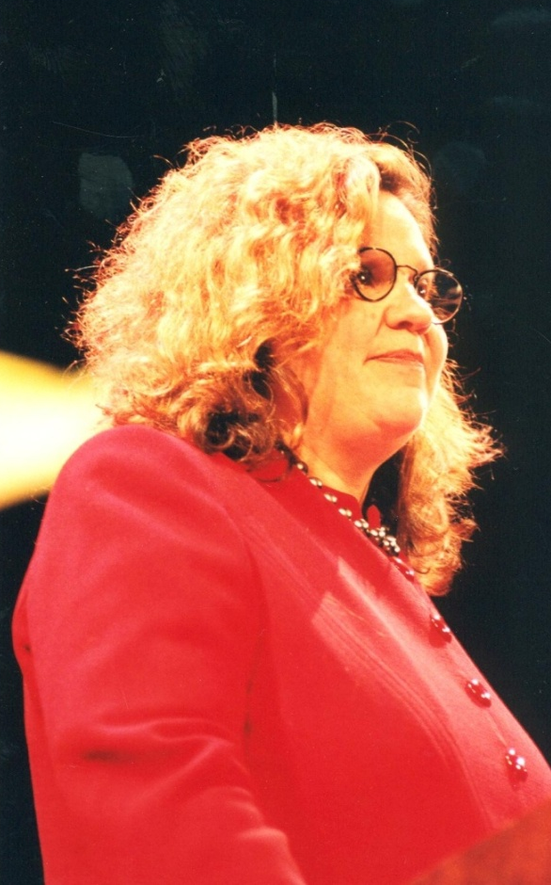
1999
“The arts reflect profoundly the most democratic credo, the belief in an individual vision or voice.”
Wendy Wasserstein
12th Annual Lecturer
Notes:
1999 Wendy Wasserstein, playwright .right

Slide 15
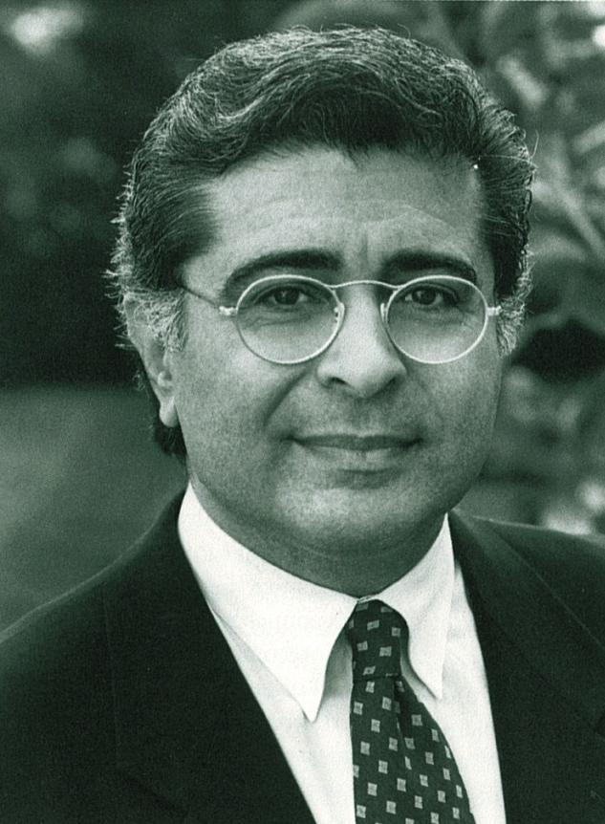
2000
“After all, arts education is really the only way to create a more knowledgeable public and new generations of leaders that will drive this creative industry, not-for-profit and for-profit alike. Art is central to a civil society. Kids who create don’t destroy.”
Terry Semel
13th Annual Lecturer
Notes:
2000 Terry Semel, immediate past Chairman and Co-CEO of Warner Bros. and Warner Music Group .left

Slide 16
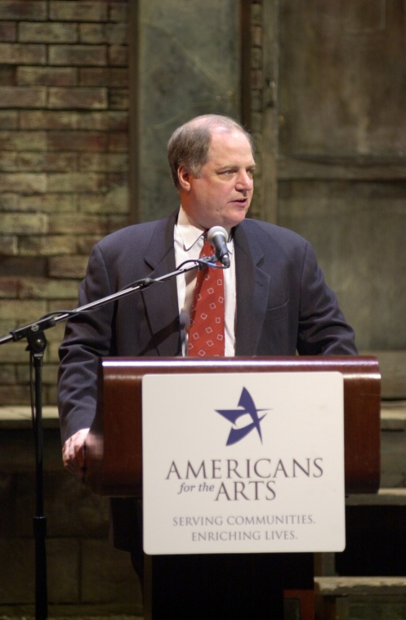
2001
“…the lasting, humane values that inform all of the arts – the beauty and catharses that lift us well above the quotidian reality of our lives – are beyond category. They carry over from art form to art form, from generation to generation, from society to society. They speak a language that once understood is never forgotten.”
Frank Rich
14th Annual Lecturer
Notes:
2001 Frank Rich, op-ed columnist for The New York Times .right

Slide 17
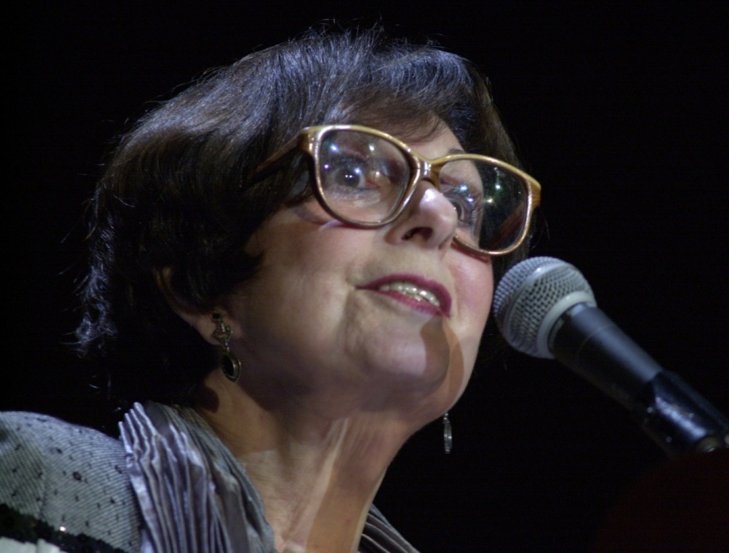
2002
“And in making art, we draw in a conscious way on the deep, rich mother load of the unconscious. What comes to the artist from that hidden place surprises and enlightens her. And she, in turn, by making the familiar strange, the ordinary extraordinary, shows the rest of us what we may never have seen.”
Zelda Fichandler
15th Annual Lecturer
Notes:
2002 Zelda Fichandler, Founding Director of Arena Stage in Washington, D.C. and Chair of the Graduate Acting Program and Master Teacher of Acting and Directing at New York University's Tisch School of the Arts

Slide 18
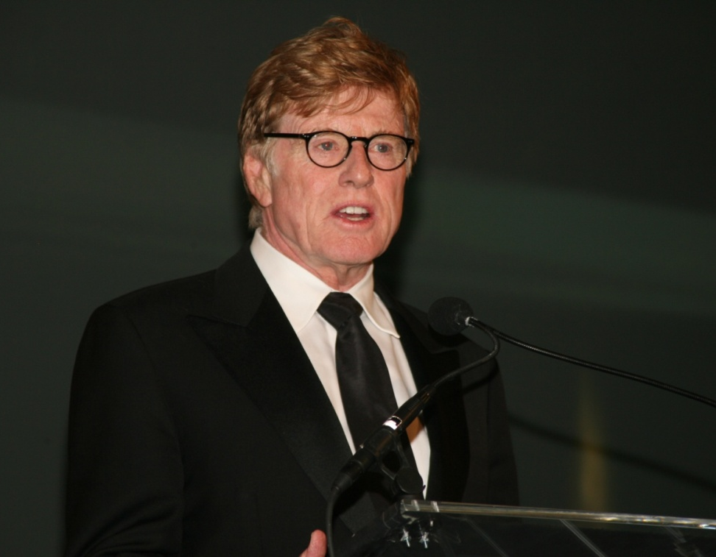
2003
“To me, art, in all its forms, is the purest reflection of the most diverse aspects of us as individuals, as communities, as nations, and as cultures. It’s art that feeds and nurtures the soul of a society, provokes thought, inspires critical thinking, and fosters understanding of things foreign to our own immediate world.”
Robert Redford
16th Annual Lecturer
Notes:
2003 Robert Redford, actor, director and activist

Slide 19
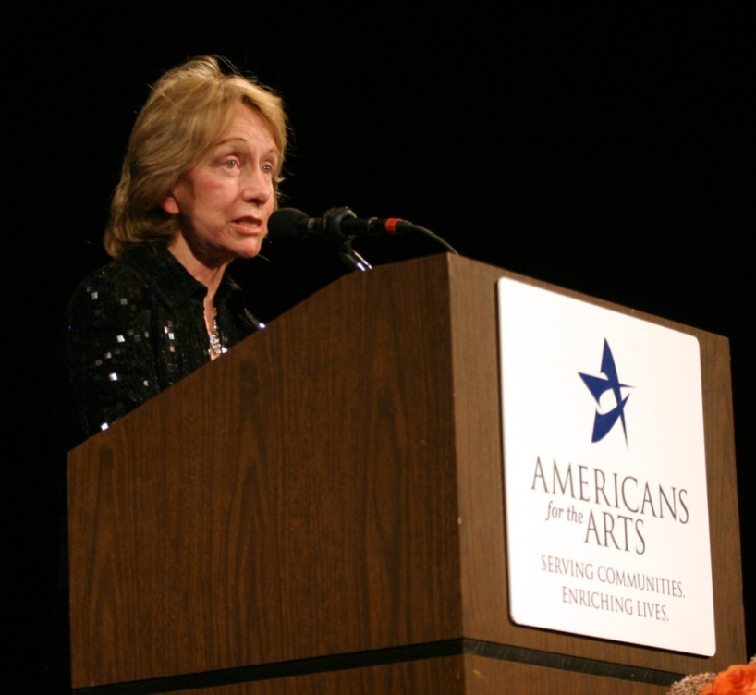
2004
“When I think about his [Abraham Lincoln’s] relationship to the world of the arts, what strikes me is that he is precisely the kind of person that the various arts programs hope to reach, a person who had little or no opportunity throughout his childhood and early adulthood to attend any kind of live performance, but whose soul thirsted after drama, poetry, and literature.”
Doris Kearns Goodwin
17th Annual Lecturer
Notes:
2004 Doris Kearns Goodwin, journalist and author

Slide 20
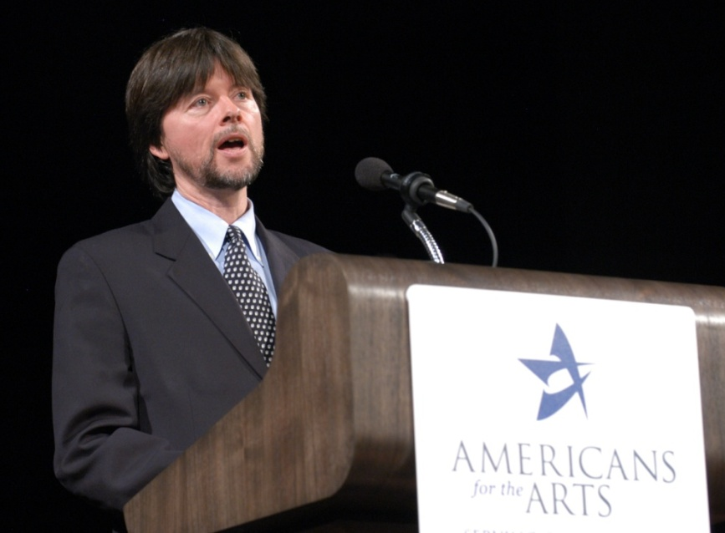
2005
“Nothing in our daily life offers more of the comfort of continuity, the generational connection of belonging to a vast and complicated American family, the powerful sense of home, the freedom from time’s constraints, and the great gift of accumulated memory than does an active and heartfelt engagement with the artistic glories…from the unforgettable individuals that inhabit our shared past.”
Ken Burns 18th Annual Lecturer
Notes:
2005 Ken Burns, documentary filmmaker

Slide 21
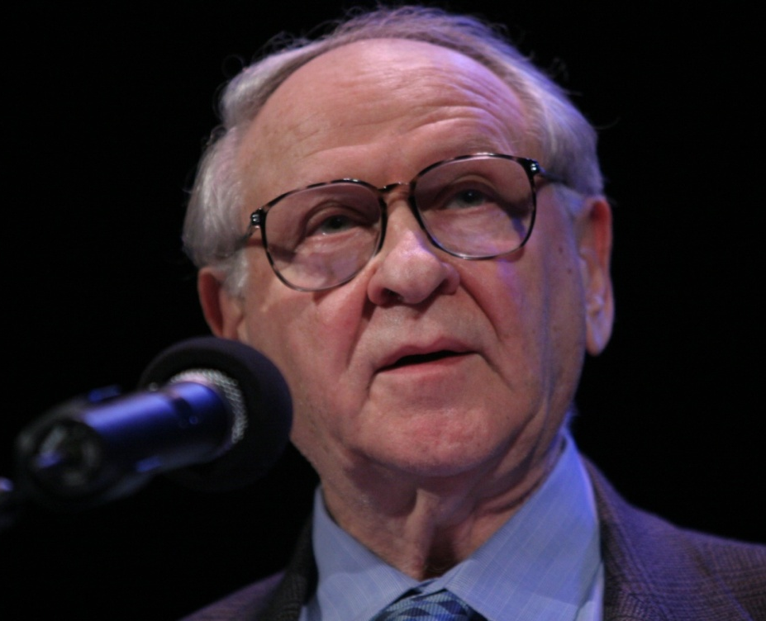
2006
“Never underestimate the power of the human brain to respond to metaphor. Never fear to make our deepest themes accessible to a wider audience. Never assume that early study of the arts in school is not connected with the development of the brain and the tuning of attention.”
William Safire
19th Annual Lecturer
Notes:
2006 William Safire, columnist and author

Slide 22
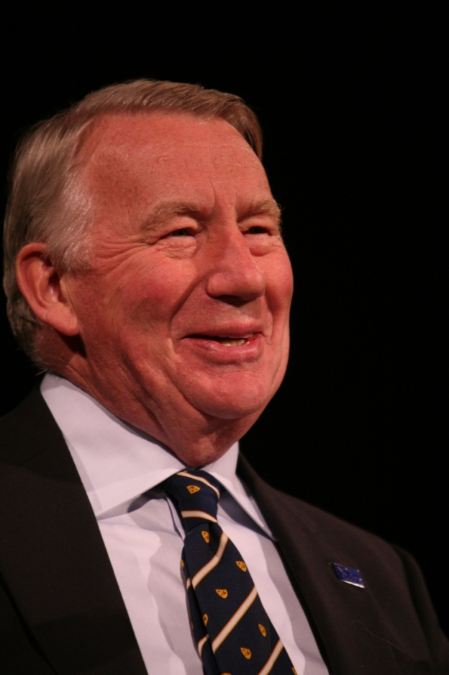
2007
“And that is what creative freedom means, to think beyond the safe, the respectable, and the orthodox…I always thought it was what the United States of America meant, what the music of Gershwin meant.”
Robert MacNeil
20th Annual Lecturer
Notes:
2007 Robert MacNeil, broadcast journalist and author

Slide 23
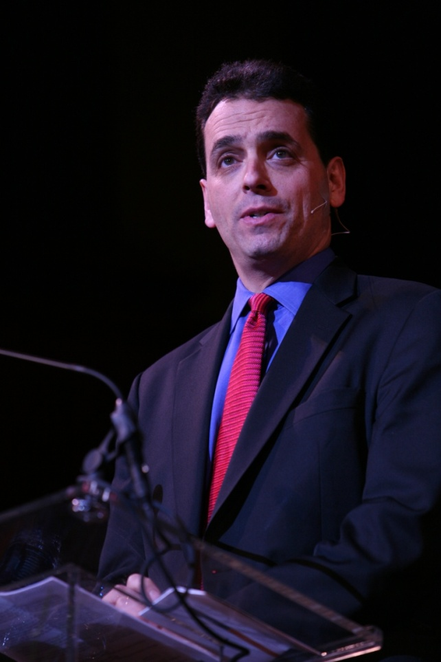
2008
“It is now abilities characteristic of the right hemisphere of the brain—artistry, empathy, inventiveness, big picture thinking—these are now the abilities that matter most, in any kind of a profession, any kind of industry.”
Daniel Pink
21st Annual Lecturer
Notes:
2008 Daniel Pink, best-selling author

Slide 24
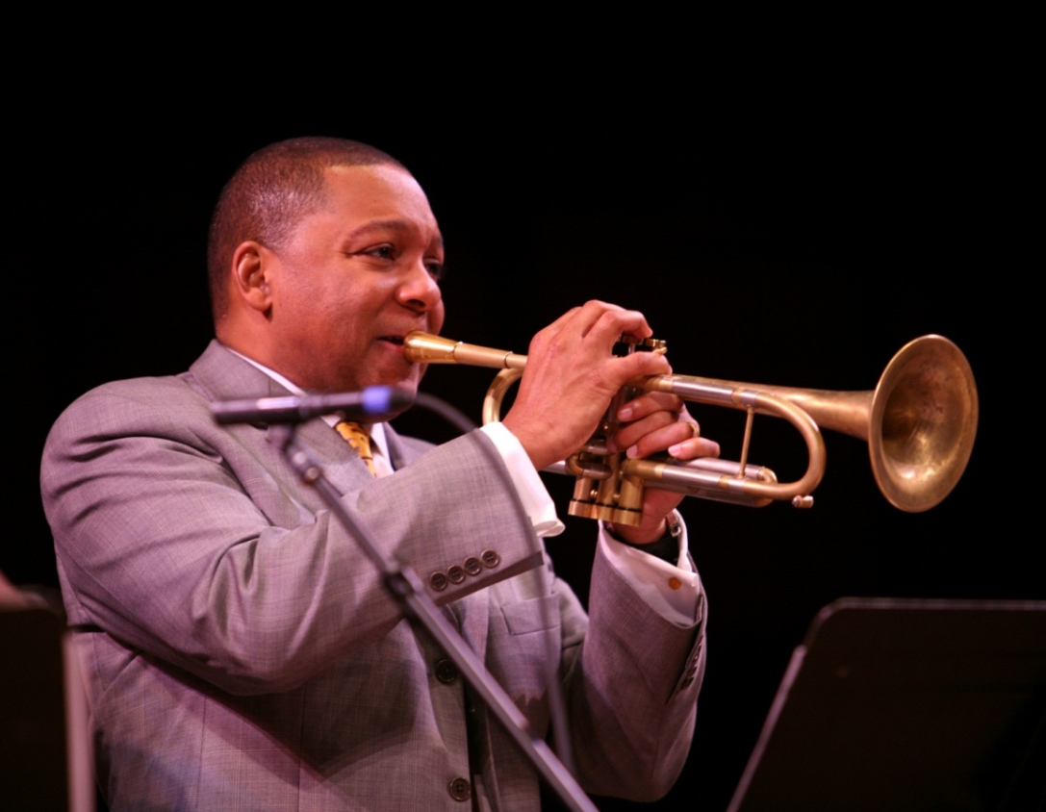
2009
“Our arts demand and deserve that we recognize the life we have lived on this land together. In this time, we need to be educated in who we are, and with the arts, education extends far outside the classroom.”
Wynton Marsalis
22nd Annual Lecturer
Notes:
2009 Wynton Marsalis, Artistic Director, Jazz at Lincoln Center

Slide 25
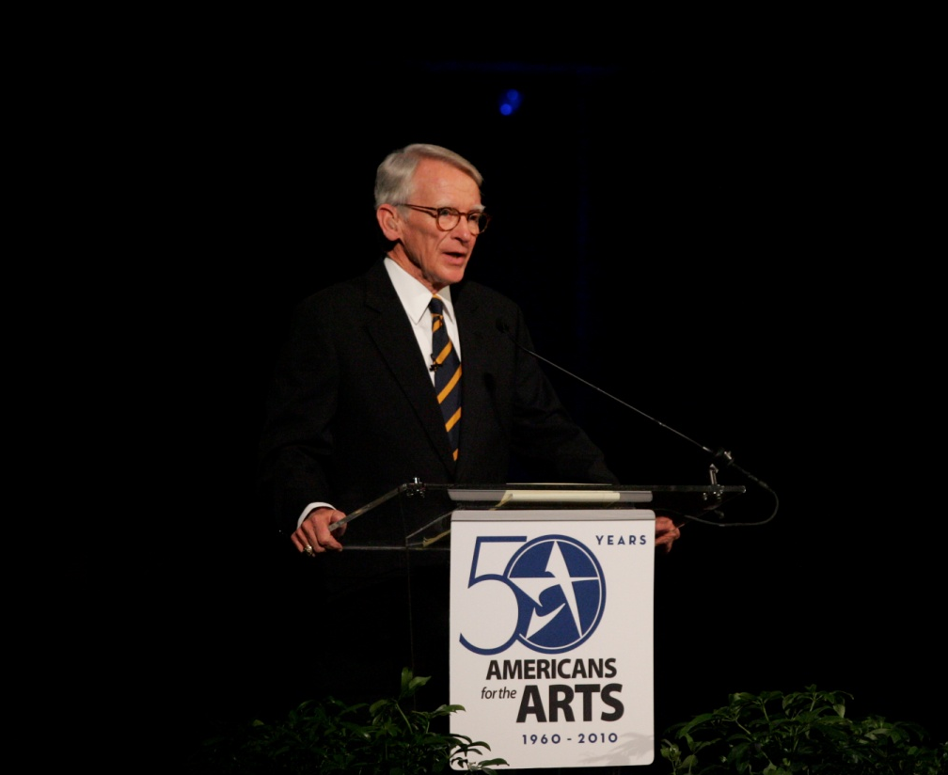
2010
“The arts have transformed my city. And I know your passion and your energy and your sacrifice and your determination and your commitment to excellence transforms the towns and cities of America.”
Mayor Joseph P. Riley, Jr.
23rd Annual Lecturer
Notes:
2010 Joseph P. Riley, Jr., Mayor, Charleston, SC

Slide 26
2012
“Because, you see, in spite of what I do for a living, in spite of how much rich creativity is potentially around me every day in my field, I get my art the way you get art, as a ticket holder, as an audience member, as a patron”
Alec Baldwin
25th Annual Lecturer

Slide 27
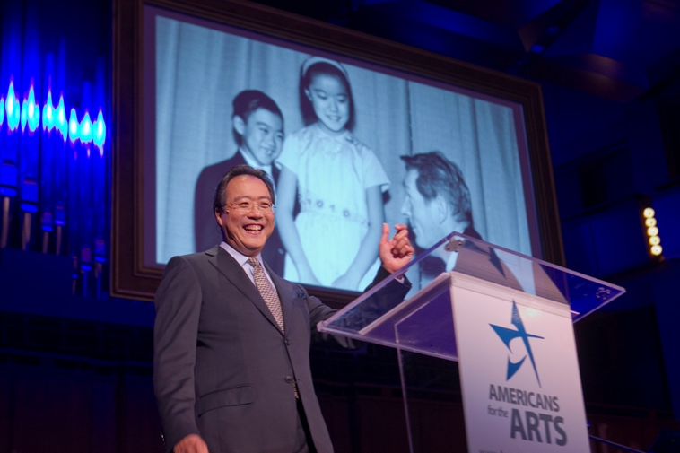
2013
“I realized that everything I practice in music, and this is true of all the performing arts, involves the four qualities necessary for success in the workforce of the 21st century: collaboration, flexibility, imagination, innovation.”
Yo-Yo Ma
26th Annual Lecturer

Slide 28
2014
“Without the arts, people would have underdeveloped imaginations. With underdeveloped imaginations, they would not lead either meaningful lives or moral lives, because without the representations of otherness in art, you cannot imagine the pain or the poverty that someone else is feeling.”
Maureen Dowd
27th Annual Lecturer

Slide 29
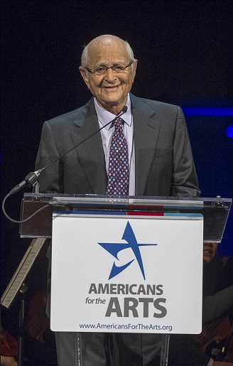
2015
“We will save our world. But when it is saved, I’m confident that the door will have been kicked open by the things that bring us together – The Arts – the music, the film, the literature, theater, painting, photography, sculpture, and dance – which cause us to see and hear as one.”
Norman Lear
28th Annual Lecturer

Slide 30
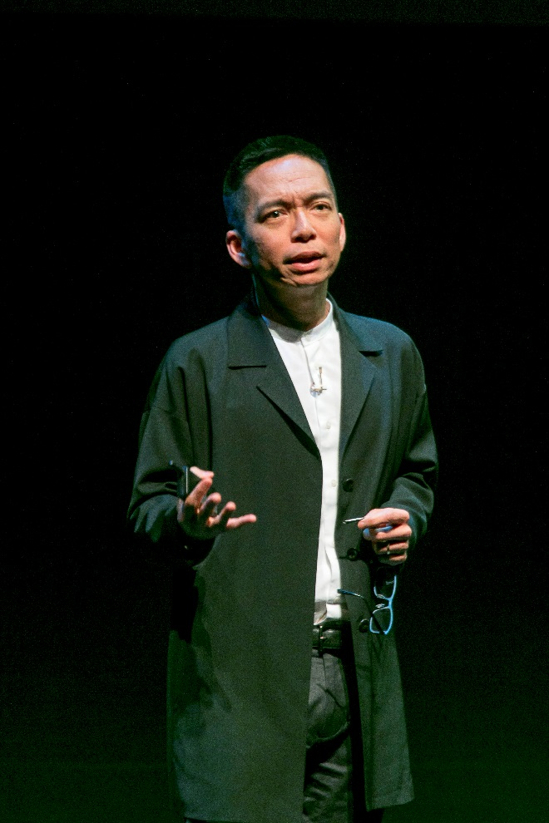
2016
“I believe that, as an artist, this is the goal in life. It’s to be curious and go wonder how to do new things.”
John Maeda
29th Annual Lecturer

Slide 31
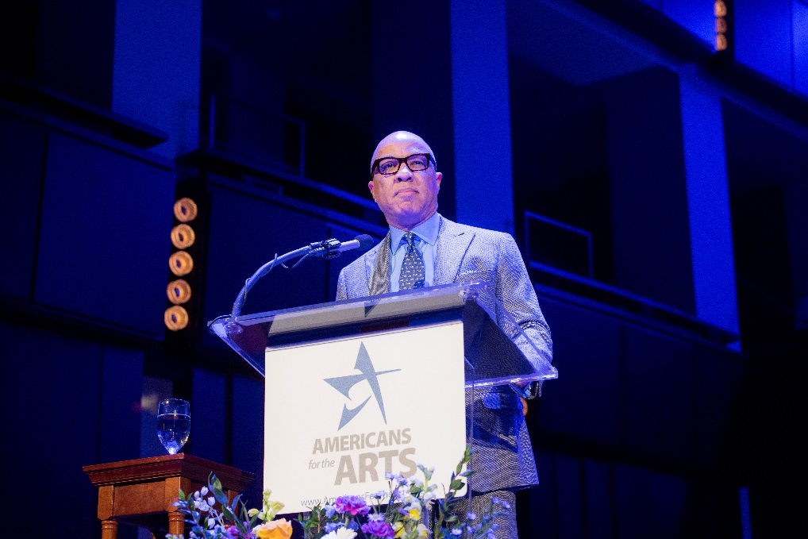
2017
“Art is not a privilege. Art is the soul of our civilization; the beating heart of our humanity; a miracle to which we all should bear witness, over and over again, in every home—from the most modest and humble to the grandest and most fashionable.”
Darren Walker
30th Annual Lecturer

Slide 32
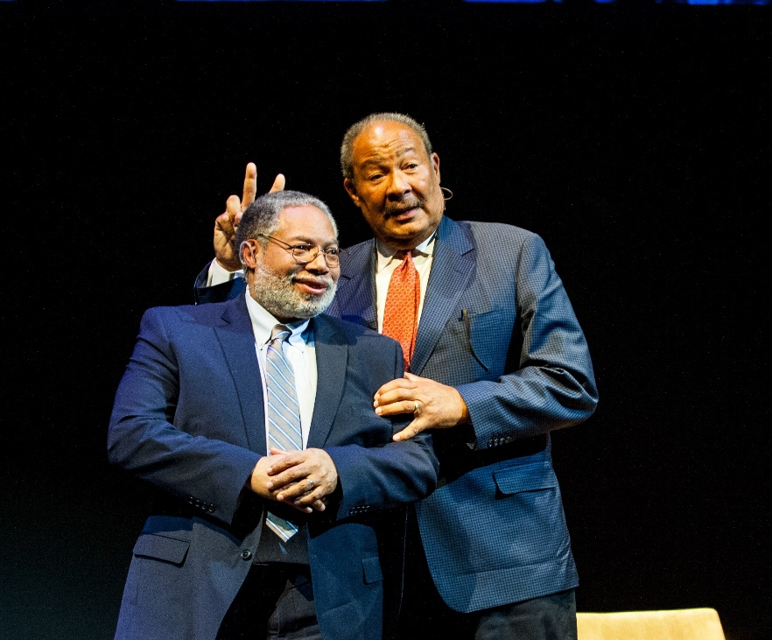
2018
“I think the arts are, candidly, the heartbeat of a country. And, if you don't pay attention to that heartbeat, the country dies.”
Lonnie G. Bunch III and Richard D. Parsons
31st Annual Lecturer

Slide 33
2019
“Great art is powerful, it’s transcendent, it lifts beyond the physical realm, it supersedes the moment. It does something special to your soul.”
Rita Moreno
32nd Annual Lecturer

