Slide 1
2024 Congressional “Earmarks” Webinar (Congressionally Directed Spending)
Americans for the Arts & Arts Action Fund
February 9, 2024
3:00 PM ET

Slide 2
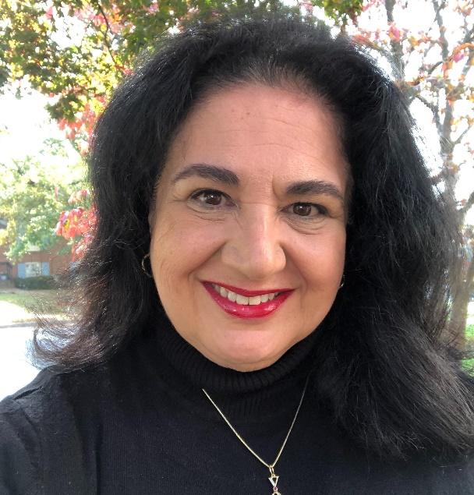
Today's Moderator
Nina Ozlu Tunceli
Chief Counsel of Gov't & Public Affairs, Americans for the Arts
Executive Director, Arts Action Fund

Slide 3
Year-Around Arts Advocacy Training
Today’s Earmarks webinar – Feb. 9, 2024
This is our second in a series of Arts Advocacy webinars that we will present in 2024.
Upcoming webinars and advocacy events:
Nancy Hanks Lecture on Arts & Public Policy – March 12, 2024
Advocacy 201 Webinar – April 2024
National Arts Advocacy Zoom/Call-In Week – May 2024
Advocacy 301 Webinar – July 2024
Advocacy 401 Webinar – September 2024
Post-Election Impact Webinar – November 2024

Slide 4
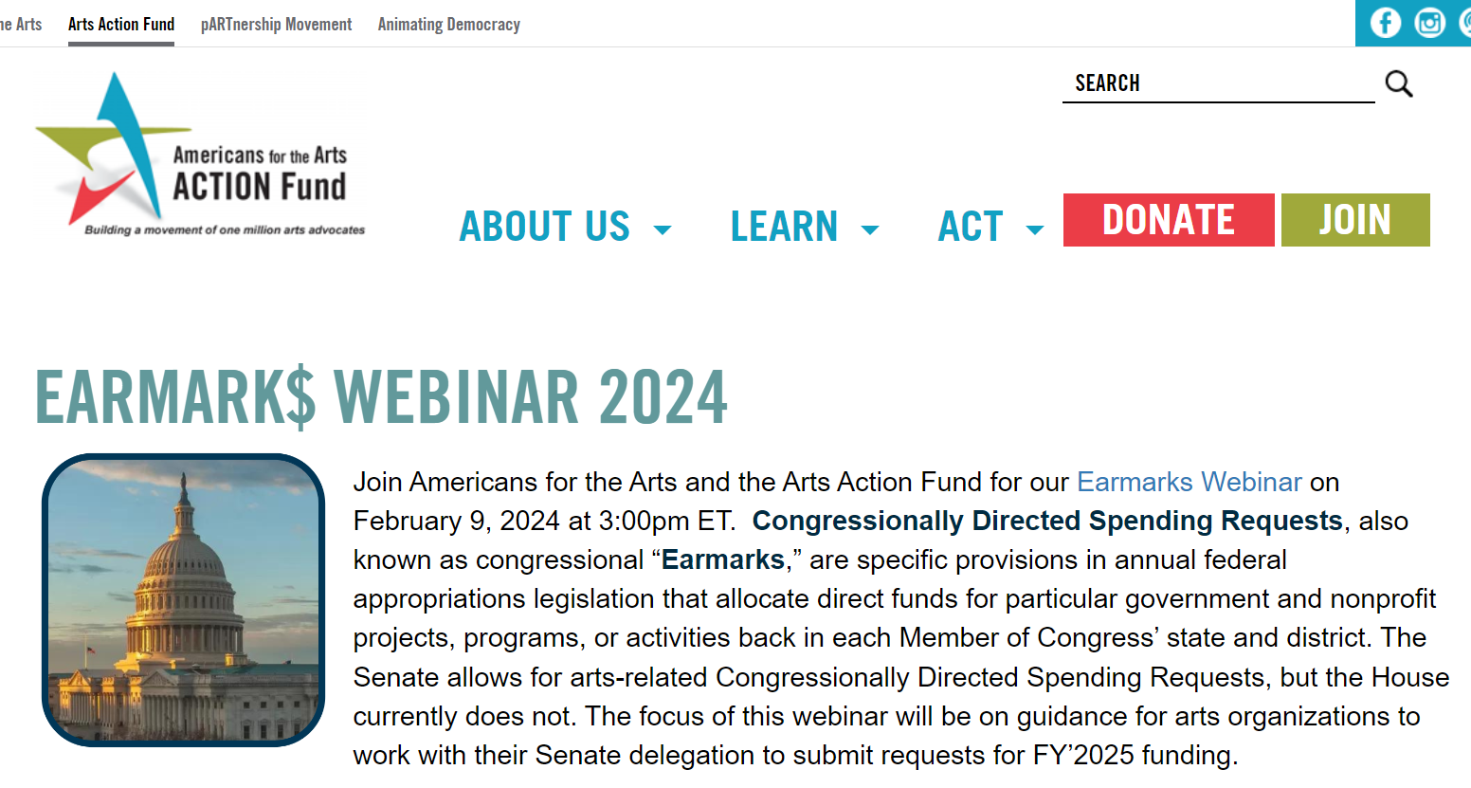
Today’s Earmarks Webinar & Slides
Earmarks Webinar Resource Page:
www.artsactionfund.org/earmark-webinar-2024
Questions:
For additional questions, please e-mail Americans for the Arts Public Policy Manager Olivia Tarpley at Otarpley@artsusa.org.

Slide 5
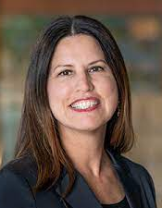
Guest Speakers
Bill Harper
Harper Downing
Roberta Downing
Harper Downing
Randall Reid Smith
Governor’s Curator for the WV Department of Arts, Culture and History
Robert Chelimsky
Managing Director,
Playwrights' Center, St. Paul, MN

Slide 6
Today's Webinar Agenda
Overview – Nina Ozlu Tunceli
Legislative Deep Dive - Bill Harper
Agency Engagement and Award Process - Roberta Downing
Hear Local/State Stories - Randall Reid Smith & Robert Chelimsky
Panel discussion and Q&A – All Speakers

Slide 7
Q&A Opportunity
Today's webinar will run less than 60 minutes with an opportunity for Q&A at the end of today's presentation.
Please ask questions in the Q&A box, where you can also up-vote a question that you want to be sure is asked and answered first.

Slide 8
Understanding Federal Fiscal Years
FY’23 = October 1, 2022 – September 30, 2023
FY’24 = October 1, 2023 – September 30, 2024

Slide 9
Federal Investment in Earmarks
FY’23 Total Earmarks = $15 billion for 7,200 projects
FY’23 Arts Earmarks = $67 million for 66 projects
Note: Combination of House and Senate Earmark investments.
FY’24 Total Earmarks = TBD $billions
FY’24 Arts Earmarks = $28.8 million for 42 projects
Note: The newly GOP controlled House disallowed Earmarks for arts projects in the FY’24 appropriations bills. It was only allowed in the Senate.

Slide 10
Congressionally Directed Spending and Community Project Funding
Engaging with Congress in Fiscal Year 2025
Presented by Bill Harper and Roberta Downing
Harper Downing LLC

Slide 11
Congressional earmarks are…
Senate: Congressionally Directed Spending (CDS)
House: Community Project Funding (CPF)

Slide 12
The House Appropriations Committee uses the definition of “Earmark” found in House rule XXI:
A “Congressional earmark” is defined as “a provision or report language included primarily at the request of a Member, Delegate, Resident Commissioner, or Senator providing, authorizing or recommending a specific amount of discretionary budget authority, credit authority, or other spending authority for a contract, loan, loan guarantee, grant, loan authority, or other expenditure with or to an entity, or targeted to a specific State, locality or Congressional district, other than through a statutory or administrative formula driven or competitive award process.”

Slide 13
Recent "Earmark" History
In 2011, congressional “earmarks” were banned.
In 2021, Congress reinstated “earmarks” for:
Non-profit organizations
Units of local, state, tribal governments
Earmarks to “for-profit” entities are banned.
In 2023, House Republicans eliminated “earmark” project funding in 5 of the 12 bills, including LHHS-ED and Financial Services appropriations bills.

Slide 14
Two Reasons to Pursue Congressionally Directed Spending or Community Project Funding
Opportunity (not a guarantee) to capture federal funding for your organization for a capital project or program.
Building and sustaining a relationship with your Senator or Representative and their staff – both in state and in Washington – that will allow for ongoing engagement on funding, policy, or support for grant funding.

Slide 15
Arts and Culture Projects Funded: FY’24
U.S. Senate:
42 Arts and Culture Projects Across 5 Bills
Estimated Total Funding: $28.8 million
U.S. House:
Arts and Culture Projects Excluded

Slide 16
Guidance for CDS/CPFs FY’25 (based on FY2024)
Only non-profit organizations and local, state, Tribal governments are eligible to submit projects
For-profit companies are banned
Memorials, museums, or commemorative are explicitly prohibited by the House Appropriations Committee
Maximum 15 projects per House member across all bills
Unlimited project submissions for Senators
DEADLINES FOR FY2025 SUBMISSION DETERMINED BY INDIVIDUAL CONGRESSIONAL OFFICES:
Quick turnaround following conclusion of FY24 bills
Check with your Senator or Representative’s office

Slide 17
FY 2025 Eligible Funding Accounts Relevant to Arts and Culture Organizations *ACCOUNTS WILL DEFINE YOUR PROJECT*
Agriculture Subcommittee
USDA – Rural Development: Community Facilities grants (House and Senate)
Financial Services Subcommittee (Senate)
National Archives
Small Business Administration
Interior, Environment Subcommittee
National Park Service – Historic Preservation Fund (Senate)
Labor, Health, Human Services, Education Subcommittee (Senate)
Dept. of Education – Innovation and Improvement/Fund for the Improvement of Education
Dept. of Education – Higher Education/Fund for the Improvement of Postsecondary Education
Transportation, Housing Urban Dev. Subcommittee
HUD – Community Development Fund/Economic Development Initiatives: capital projects (House and Senate)

Slide 18
Basic Project Information Required by Members and Committees
Project Name
Project Purpose
Short narrative description that will be made public if project is selected.
Think:
What would the funding accomplish?
Who will the project serve or benefit?
Why are the funds needed?
Justification of Request
Project details
Why is this a good use of taxpayer funds?
Answer specific account criteria
New or expanded services or opportunities for a population, geographic area, or partnership?
If an ongoing project, what is the current project status?

Slide 19
Basic Project Information Required by Members and Committees
Project Costs
Costs and how the funding will be spent?
Salaries, programming, equipment
If project phases, cost per phase
Total financing picture
Are state, local, or private dollars being contributed to the project?
“Shovel Ready:” projects that can start immediately or have started are prioritized
Completion in fiscal year is NOT required
Demonstrate Support from Community/Stakeholders/Validators
Letter of support for project will be required

Slide 20
Senate CDS Timeline and Process
Senate Appropriations Committees have NOT yet released criteria and eligible accounts for CDS project for FY2025.
Does your Senator submit CDS on behalf of constituent organizations? Not all Senators submit projects.
Don’t assume, call your Senator.
Ask for information about their CDS process and get to know the staff member coordinating the process.
Find out: What are their deadlines for submission?
Define your project, follow the established criteria, and submit your project request to individual Senator by their office deadlines
Individual offices set their own deadlines

Slide 21
Senate CDS Timeline and Process
Individual Senators and Representatives evaluate and select projects to be submitted to the Senate/House Appropriations Committees – highly competitive process
Senators can submit unlimited projects
House: 15 project limit
House/Senate Appropriations Committees review and select projects to include in FY2025 appropriations bills
Appropriations Committees move FY2025 appropriations bills through the subcommittee process with CDS included in the “committee report” accompanying the subcommittee’s bill
A project included in a bill’s subcommittee report that passes the full Appropriations Committee will be included in the final conference report unless explicitly removed.

Slide 22
Senate CDS Timeline and Process
It is now normal for the federal fiscal year to end on Sept. 30th without the appropriations process being concluded, requiring Congress to pass a Continuing Resolution (CR) to keep the federal government operating:
This impacts final funding distribution
FY2024 CRs expire March 1 and March 8
Senate and House Appropriations subcommittees “conference” their bills to merge Senate and House CDS
Individual, “minibus,” or an “omnibus” appropriations bill passed by Congress and signed into law by POTUS – projects are funded
Federal agencies responsible for funding distribute funds typically in Q3 or Q4 of fiscal year – April to September of 2025 – but extended CRs can push this timeline out

Slide 23
CDS SUCCESS!
CONGRATULATIONS!
Your organization’s project has been included in the final appropriations bill … now what?
Engage with federal agency program office/program officer to coordinate requirements and timeline.
Project must comply with existing agency regulations and program criteria associated with the funding’s source
Examples: USDA Rural Development / match required NPS – Save America’s Treasures
Work with your congressional sponsor to help navigate the agency process if barriers/problems arise.
Do not commit to spending project funding until it is received!

Slide 24
Remember
This is a HIGHLY competitive process
There is NO guarantee of funding
Work cooperatively and collaboratively with your Congressional offices
Build a relationship with the Congressional office that will be sustained
Good luck!

Slide 25
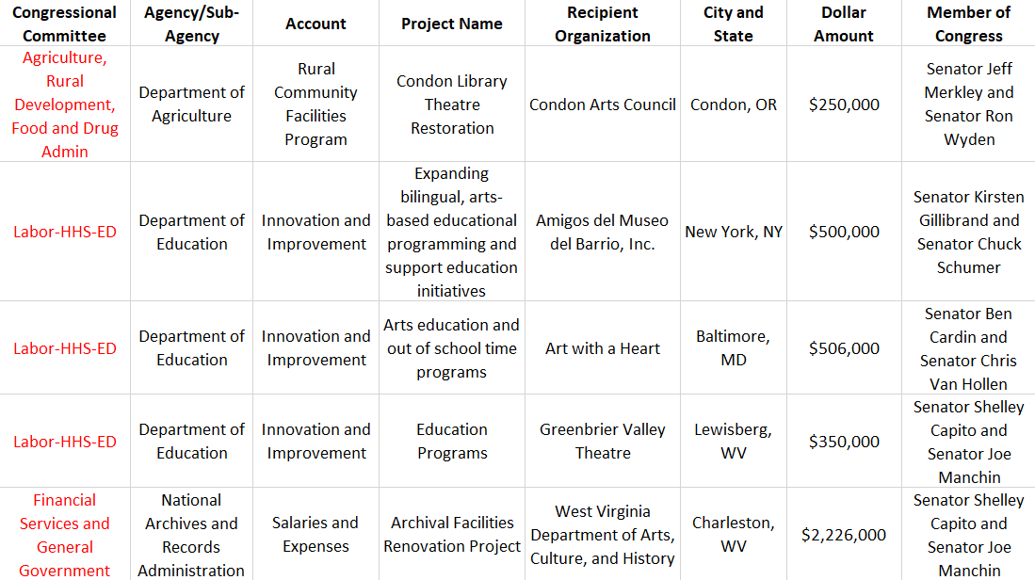
FY'24 Arts Related Earmarks
docs.google.com/spreadsheets/d/1aIWA9ivyeh41Rb-mZRIY6lmTbPP7ARpVTTAg0-J9XLk/edit?usp=sharing

Slide 26
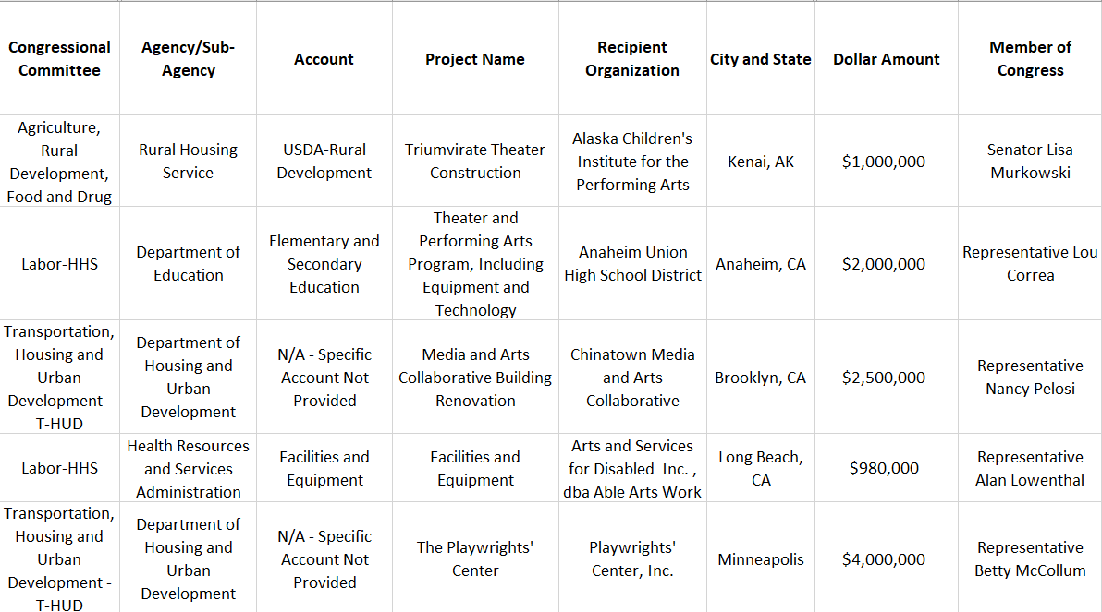
2023 Arts Related Earmarks
docs.google.com/spreadsheets/d/1S8-ivzH10WwgPd-K6oUE6pL6rZaLlk2LHSto9-VKE6k/edit?usp=sharing

Slide 27
Useful Resources (Will update as new FY'25 info is released)
Senate Guidance for last year’s FY’24 Requests (not available yet for FY’25):
www.appropriations.senate.gov/imo/media/doc/FY2024%20Appropriations%20Requests%20General%20Guidance.pdf
List of the FY’24 “Projects in the Senate Bills” for FY’24 Appropriations:
www.appropriations.senate.gov/fy-2024-congressionally-directed-spending
List of all FY’24 “Member Requests” submitted by Senators (alpha order), but most were not included in final appropriations bills:
www.appropriations.senate.gov/fy-2024-congressionally-directed-spending
List of Arts-Related Projects-only in the Senate bills for FY’24 Appropriations:
docs.google.com/spreadsheets/d/1aIWA9ivyeh41Rb-mZRIY6lmTbPP7ARpVTTAg0-J9XLk/edit?usp=sharing
List of Arts-Related Projects-only in the House & Senate bills for FY’23 Appropriations:
docs.google.com/spreadsheets/d/1S8-ivzH10WwgPd-K6oUE6pL6rZaLlk2LHSto9-VKE6k/edit?usp=sharing

Slide 28
Thank you. Reminder of where you’ll find today’s webinar recording, slides & resources.
Earmarks Webinar Resource Page:
www.artsactionfund.org/earmark-webinar-2024
Questions:
For additional questions, please e-mail Americans for the Arts Public Policy Manager Olivia Tarpley at Otarpley@artsusa.org.

